Slide 1
Computer Science
Tony Gaddis 5th Ed Starting Out with C++
Chapter 3
Expressions and Interactivity
Mohammad Al-Husseini

Slide 2
The cin Object
So far all of your programs have had built in data
Obviously, useful programs need to get input from outside
And store them in variables
The cin object is the standard input object and accomplishes this task

Slide 3
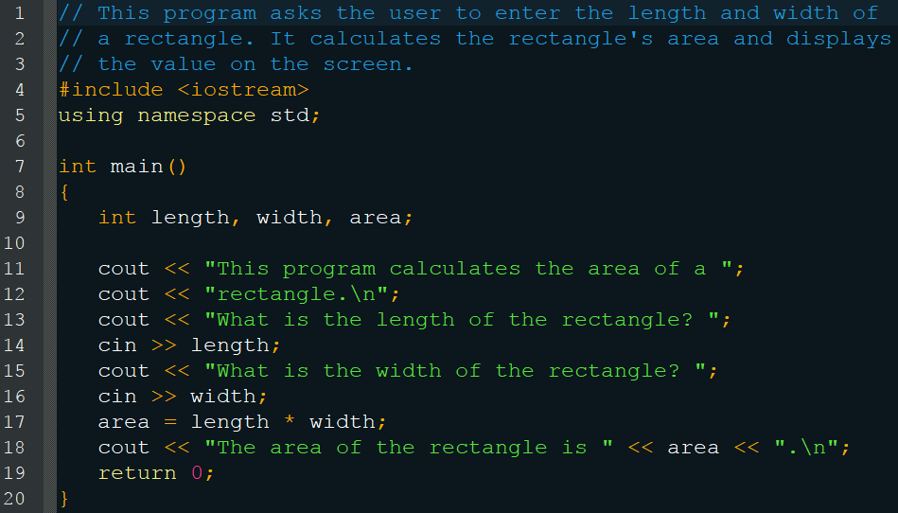
The cin Object

Slide 4
The cin Object
Gathering input from a user is normally a two step process
Use the cout object to display a prompt
Use the cin object to read a value
#include <iostream> is required for both the cout and cin objects
cout << “Something”; // stream insertion op
cin >> variable; // stream extraction operator
Think of these like arrows, pointing where the data is going to or coming from

Slide 5
The cin Object
Note that the cout object completes and continues
But the cin object waits for the user to press [Enter] before continuing the code

Slide 6
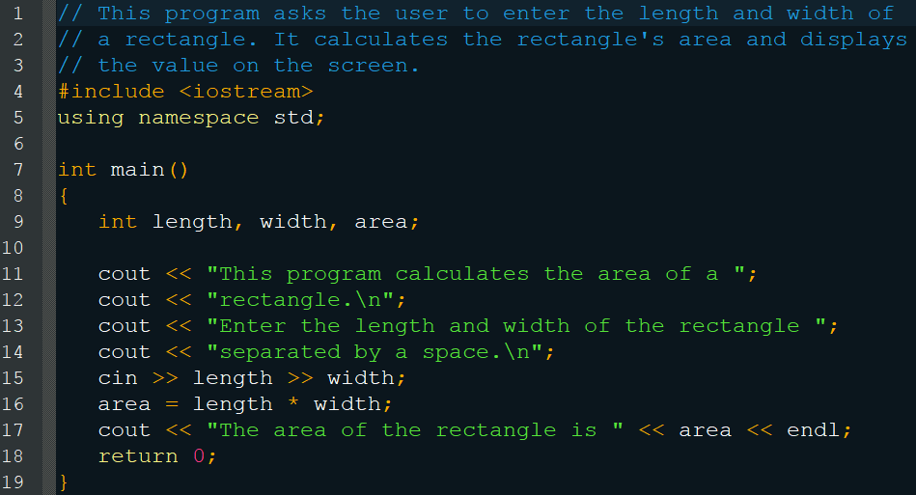
cin Multiple Values
10 20[Enter]

Slide 7
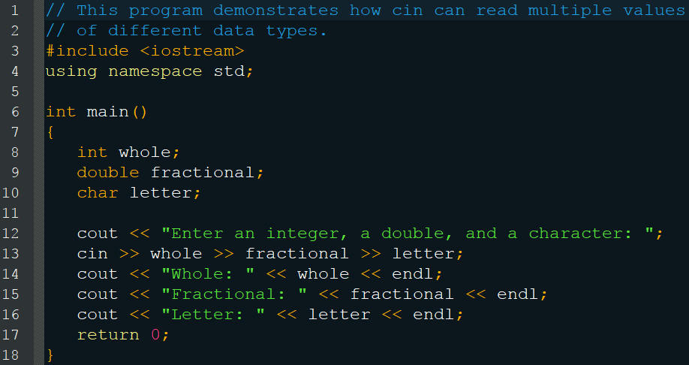
cin Multiple Values
5.7 4 b[Enter]

Slide 8
The Keyboard Buffer
Enter an integer, a double, and a character: 5.7 4 b[Enter]
int = 5
double = .7
char = 4
b is left in the keyboard buffer for the next cin
Be careful when mixing multiple inputs
5 | . | 7 |  | 4 |  | b | [Enter]

Slide 9
Reading Strings
Cannot store a string (>2 characters) in a char
Use a character array to store strings instead
char company[12];
Must be large enough to hold the number of characters in the string + 1 (for the \0)
So company can hold 11 characters, since the last character will be the null terminator
Be warned, if you store a larger string, it will accept it and run past its bounds to erase other data (overflow)

Slide 10
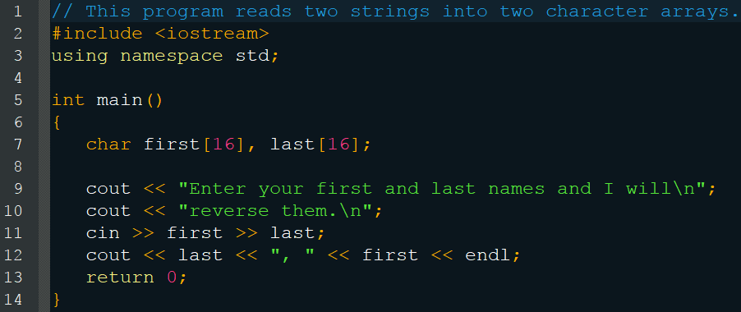
Reading Strings
Johnny Jones[Enter]
Jones, Johnny
You could do this as one string but cin doesn’t accept white space (solution coming soon)

Slide 11
Mathematical Expressions
sum = 21 + 3;
The value of 21 + 3 must be determined
The addition operator returns the value 24
sum = 24;
sum is then set equal to 24 by the assignment operator
And the expression is completed
Don’t be tempted to store every calculation into a variable
If you only use it once, you don’t need to store it

Slide 12
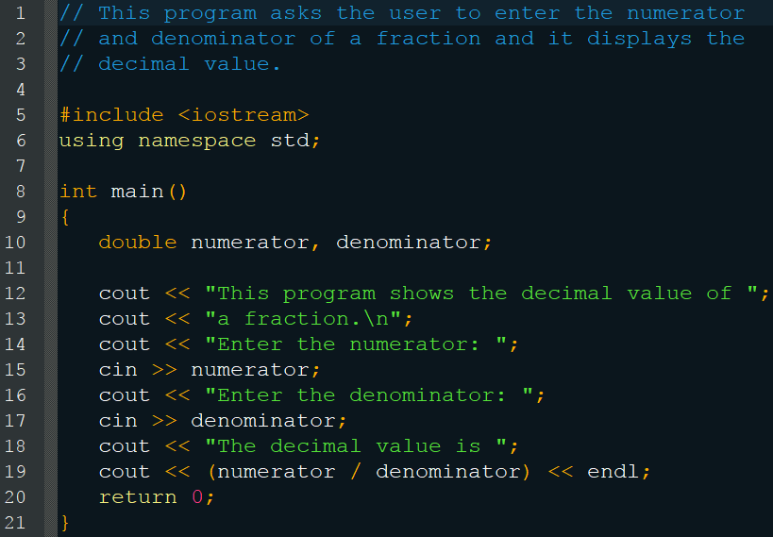
Mathematical Expressions

Slide 13
Overflow and Underflow
If you assign a value to a variable that is too large for it to hold, then it overflows
If you assign a value to a variable that is too low (negative) for it to hold, then it underflows
You will get unexpected results
You will search for bugs, but there will be none
Look for a wrap around behavior

Slide 14
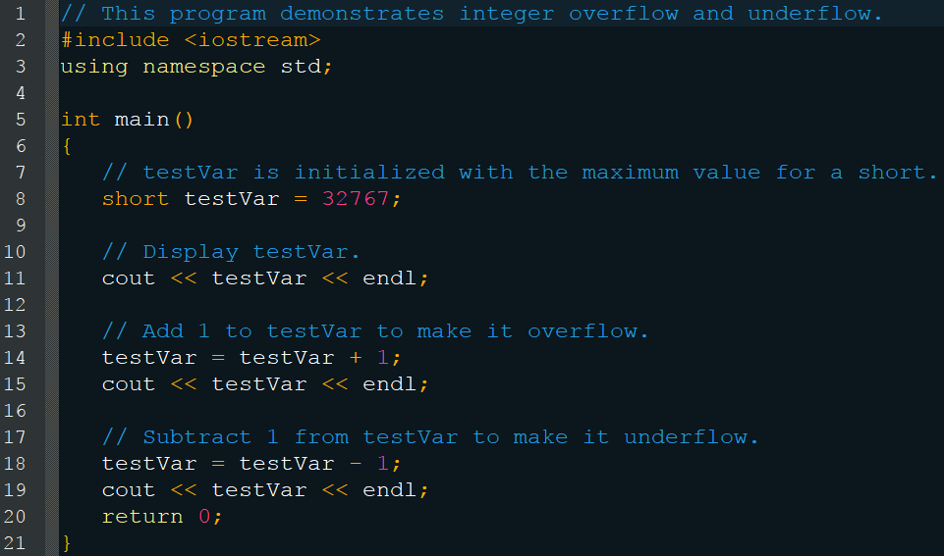
Overflow and Underflow
32767
-32768
32767

Slide 15
Operator Precedence
outcome = 12 + 10 / 5 * 2 - 8;
outcome = 12 + 2 * 2 - 8;
outcome = 12 + 4 - 8;
outcome = 16 - 8;
outcome = 8;
Left to Right
When two operands are shared, the operator with the highest presence activates first
result = 1 + 1 + 1 * 5;
result = 2 + 1 * 5;

Slide 16
Operator Precedence
Operators from highest to lowest
()
- unary negation
* / %
+ -
=

Slide 17
Operator Associativity
The order that an operator works in
- unary negation
Right to left
* / %
Left to right
ex = 4 * 4 / 4;
ex = 16 / 4;
+ -
Left to right

Slide 18
Multiple Assignment
You may assign values to multiple variables at once
int a, b, c, d; a = b = c = d = 12;
Stores the value 12 in each variable
This works because the assignment operator works right to left and returns its value upon completion
a = b = c = (d = 12);
a = b = (c = 12);
a = (b = 12);
a = 12;
12

Slide 19
Combined Assignment
You can perform simple arithmetic with assignment in one statement
number = number + 2;
number += 2;
+=
-=
*=
/=
%=

Slide 20
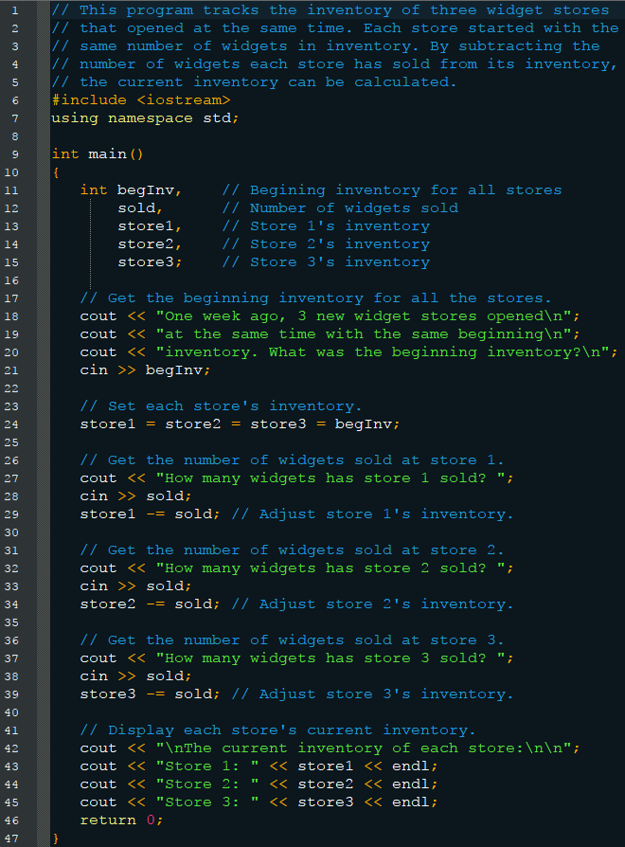
Combined Assignment

Slide 21
Combined Assignment

Slide 22

Converting Algebra
a = (3 * x + 2) / (4 * a - 1);
Fairly straightforward for the operators you know
Note: there is no exponent operator in C++
You must use a function contained in the cmath library
You may also express numbers in e notation
double num1 = 3.2e10;
double num2 = 1.8e-2;

Slide 23
Exponents
#include <cmath>
area = pow(4.0, 2.0);
Function’s name is pow
Parenthesis contains the two arguments
(double base, double exponent)
Returns the result of 4² as a double
area_of_circle = 3.14159 * pow(radius, 2.0);
You can use a function as part of an expression
And you can use variables as arguments to the function

Slide 24
More cmath Functions
You can combine functions to make complex math
c = sqrt(pow(a, 2) + pow(b, 2));
Function | Example | Description
cos | y = cos(x); | Returns the cosine of the radian double x
sin | y = sin(x); | Returns the sine of the radian double x
tan | y = tan(x); | Returns the tangent of the radian double x
log | y = log(x); | Returns the natural log of the double x
log10 | y = log10(x); | Returns the base-10 log of the double x
exp | y = exp(x); | Returns the base-e exponential function of the double x
abs | y = abs(x); | Returns the absolute value of the integer x
sqrt | y = sqrt(x); | Returns the square root of the double x
fmod | y = fmod(x, z); | Returns the remainder of x ; z as a double Same as modulus but for floating point Make certain that z is non-zero

Slide 25
Random Numbers
Requires #include<cstdlib>
rand()
Returns a random number
Well… pseudorandom
The results will always be the same, every time you run the program
cout << rand() << endl; cout << rand() << endl;
Run 1: 12 3
Run 2: 12 3

Slide 26
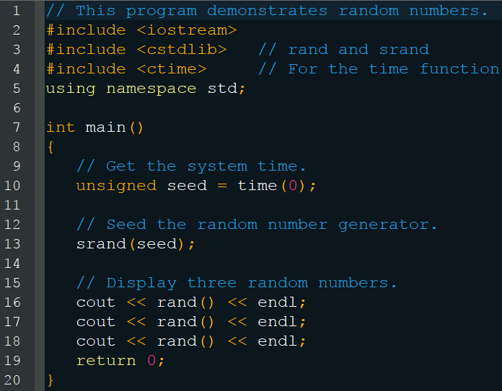
Random Numbers
Use srand(seed) to become more random

Slide 27
Random Numbers
You can manipulate the range of random numbers with some clever math
y = 1 + rand() % maxValue;
y = 1 + rand() % 100; // Rand varies 1-100
Assume rand returns 37894 37894 % 100 = 94 94 + 1 = 95
Assume rand returns 500 500 % 100 = 0 0 + 1 = 1
Assume rand returns 2999 2999 % 100 = 99 99 + 1 = 100

Slide 28
Random Numbers
We can take this one step further
y = rand() % range + minValue where range = maxValue - minValue + 1
Assume we want a number between 3 and 12 range = 12 – 3 + 1 = 10 y = rand() % 10 + 3
Assume rand returns 37894 37894 % 10 = 4 4 + 3 = 7
Assume rand returns 500 500 % 10 = 0 0 + 3 = 3
Assume rand returns 2999 2999 % 10 = 9 9 + 3 = 12

Slide 29
Type Conversion
What happens when an int is multiplied by a float, what data type is the result?
C++ automatically promotes or demotes the operands to be the same type (type coercion)
Data Type Ranking
long double
double
float
unsigned long
long (if int is the same size as long then demote 1)
unsigned int
int

Slide 30
Type Conversion
Rules
chars, shorts, and unsigned shorts are automatically promoted to int
If an operator works on operands of different types, then the lower-ranking value is promoted to the higher-ranking one
int * double -> double * double
When the final value of an expression is assigned to a variable, it is converted to the type of the variable
long double = int * double
long double = double
long double

Slide 31
Integer Division
Whenever you divide an integer by an integer, the result will be an integer and any remainder will be discarded
double parts; parts = 21 / 10;
double = int / int;
double = int;
parts = 10;
Now the 10 gets promoted to a double to store in it in parts, but the remainder was already lost

Slide 32
Type Casting
You are able to manually promote or demote
static_cast<DataType>(Value)
double number = 3.7; int val; val = static_cast<int>(number);
Practical for avoiding integer division with variables

Slide 33
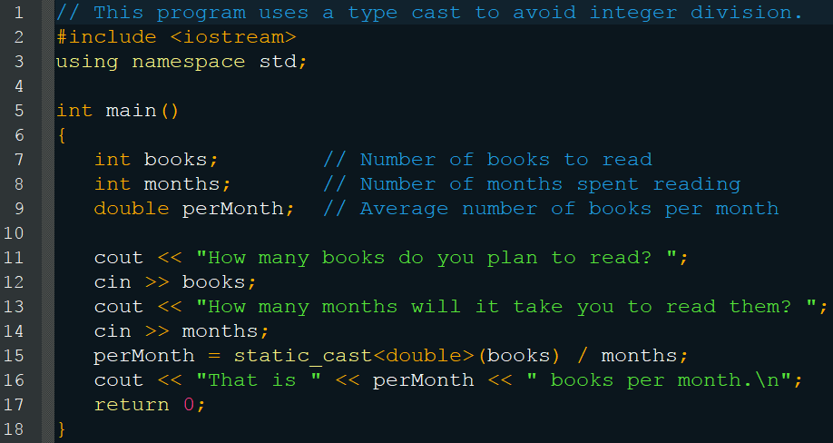
Type Casting
perMonth = static_cast<double>(books / months); Integer division happens before the cast (wrong)

Slide 34
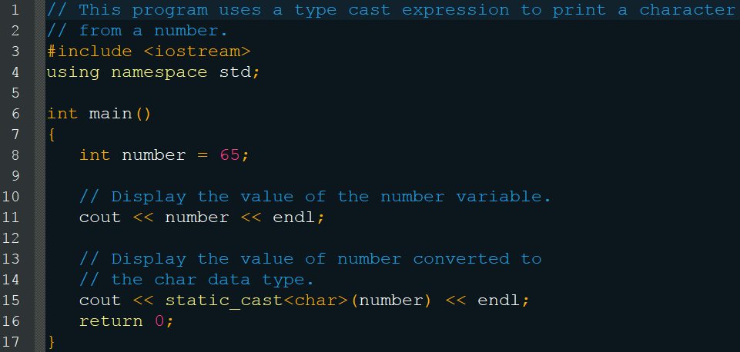
Type Casting
65 A

Slide 35
Type Casting
C++ also supports two older methods for type casting
perMonth = (double)books / months;
perMonth = double(books) / months;
static_cast<>() is preferable however
Checked by the compiler
Clearer/More easily found

Slide 36
Named Constants
Uses the const keyword before the data type
Value cannot change after creation
Convention suggests it be named with all capital letters and underscores
Generally declared at the top of the code
Good to use because if the value needs to change, you only have to change it in one place
Its also clearer to read as well

Slide 37
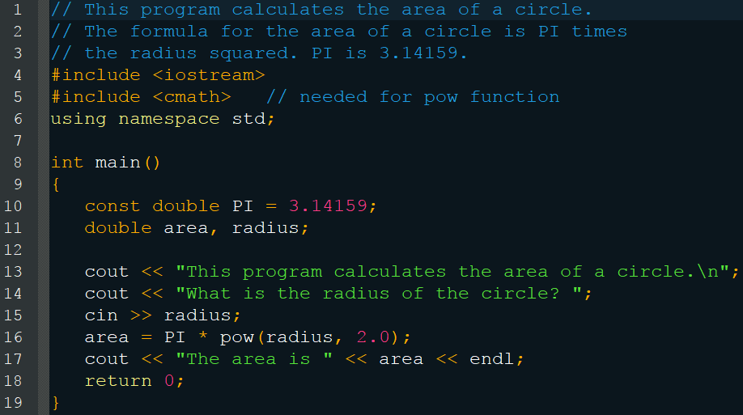
Named Constants

Slide 38
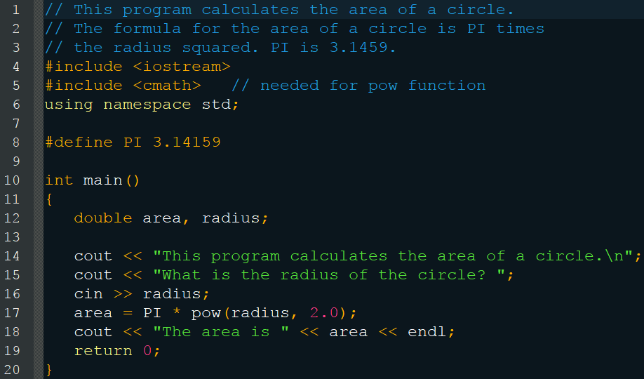
Named Constants
More memory efficient (no variable created)

Slide 39
Formatting Output
The following are all the same number:
720
720.0
720.000000000
720
7.2e+2
+720
You can control how these numbers are displayed and more

Slide 40
setw()
Causes cout to display the data in a field of a certain size (width)
The argument is an integer representing the width of the field
It pads the field with leading spaces by default
You can later adjust its justification to be left and change what character it fills the field with
If the field is not large enough for the data, it will be displayed but formatting will be lost
You must #include <iomanip>

Slide 41
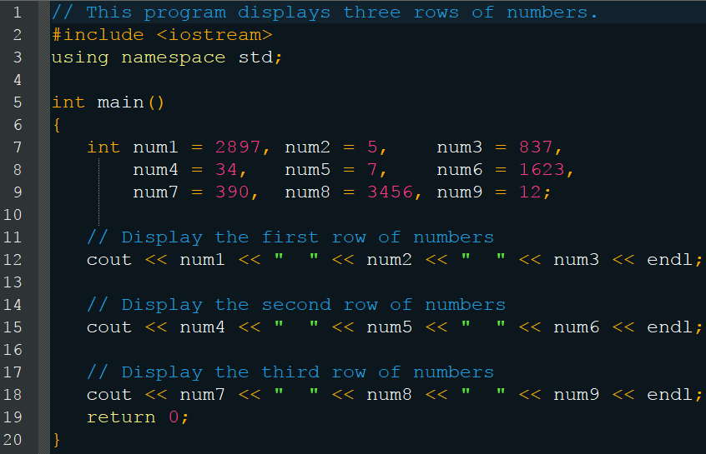
setw()
2897 5 837
34 7 1623
390 3456 12

Slide 42
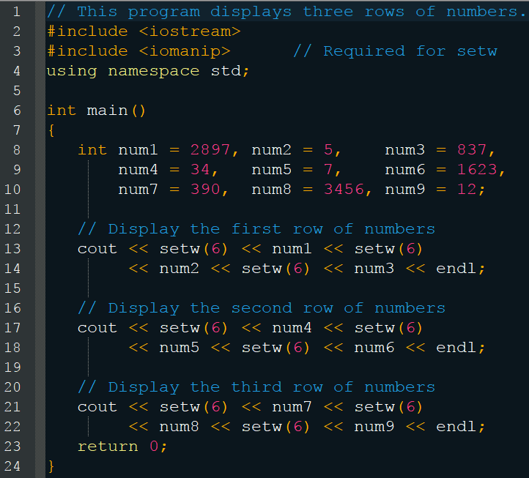
setw()
2897 | 5 | 837
34 | 7 | 1623
390 | 3456 | 12

Slide 43
setprecision()
Causes floating-point numbers to be rounded to a certain number of significant digits
The argument is an integer number representing how many significant digits
Rounds as you would expect
Requires #include<iomanip>
Stays in effect until you call the function again with a different value

Slide 44
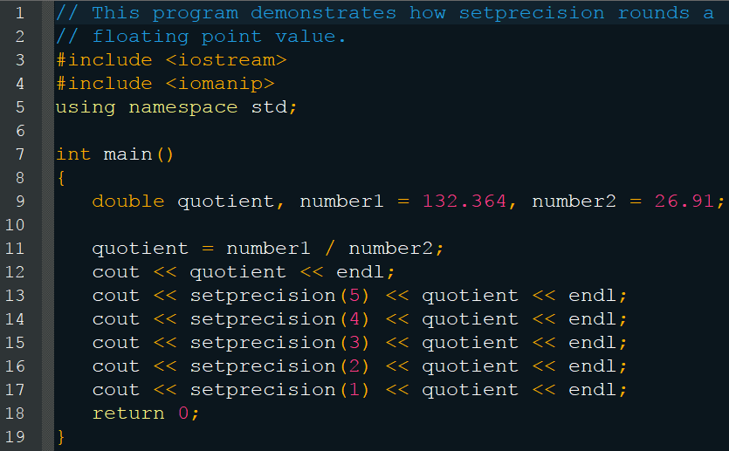
setprecision()

Slide 45
setprecision()
4.91877
4.9188
4.919
4.92
4.9
5
Remember, its significant digits not decimal
Number | Manipulator | Display
28.92786 | setprecision(3) | 28.9
21 | setprecision(5) | 21
109.5 | setprecision(4) | 109.5
34.28596 | setprecision(2) | 34

Slide 46
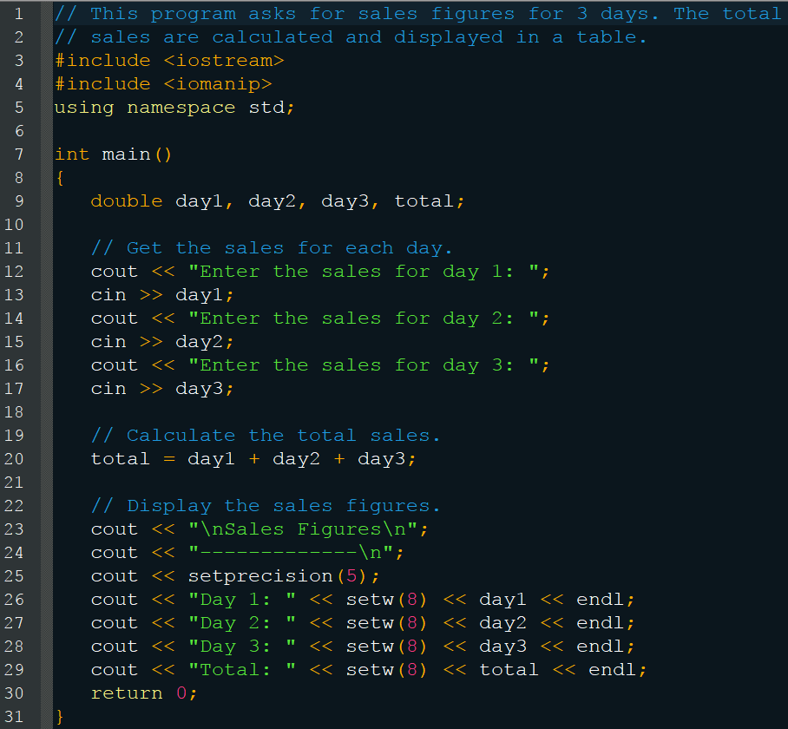
setprecision()

Slide 47
setprecision()
Sales Figures ------------------ Day 1: 321.57 Day 2: 269.62 Day 3: 307.77 Total: 898.96

Slide 48
fixed
If setprecision’s argument is too low for a number, it can print it in scientific notation
It also makes more sense to deal with decimal digits
Using fixed with setprecision forces it to operate based on decimal digits (fixed point notation)

Slide 49
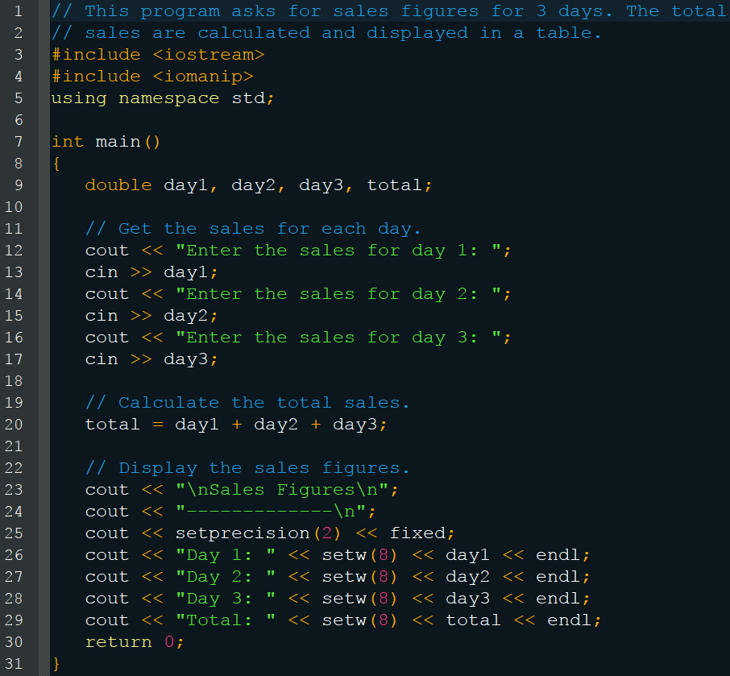
fixed

Slide 50
fixed
Sales Figures ------------------ Day 1: 321.57 Day 2: 269.62 Day 3: 307.77 Total: 898.96

Slide 51
showpoint
Even with setprecision(2) and fixed, if a number is an integer then no trailing 0’s will be displayed, this is problematic for money
cout << setprecision(2) << fixed << 23;
23
cout << setprecision(2) << fixed << showpoint << 23.5;
23.50
cout << setprecision(6) << showpoint << 23;
23.0000

Slide 52
left and right
By default output is right-justified
cout << setw(5) << 146; cout << setw(5) << 24.2; cout << setw(5) << 3;
You can use the left manipulator instead
cout << left; cout << setw(5) << 146; cout << setw(5) << 24.2; cout << setw(5) << 3;
This stays in effect until you use the right manipulator
146
24.2
3
146
24.2
3

Slide 53
Formatting Input
Like the cout object, the cin object can also perform formatting
Recall that character arrays have to be large enough to hold the string + 1 (null terminator)
If you store more than it can hold, it will overwrite subsequent data
You can use setw(), as with cout, to prevent this
char word[10]; cin >> setw(10) >> word;
This accounts for the null terminator, allowing only 9 characters to be stored, anything extra is discarded

Slide 54
Reading a Line of Input
If you’ve ever tried to cin something with spaces or tabs, you might notice odd results
If you want to read whitespace data you must use a member function of the cin object
cin.getline(variable, size);
The first argument is the variable you want to store the string into
The second argument is the maximum number of characters you want to read, including the null terminator
It will read until size – 1 characters or it encounters the newline character \n (enter)

Slide 55
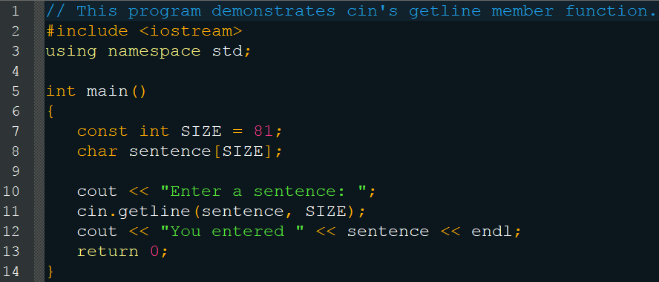
Reading a Line of Input
Enter a sentence: To be, or not to be, that is the question. [Enter]
You entered To be, or not to be, that is the question.

Slide 56
Reading a Character
Rather than using a character array to store a string, you can store a single character
You can use the char type
char ch; cout << “Type a character and press Enter: ”; cin >> ch; cout << “You entered “ << ch << endl;
This only stores a single character because cin knows that char can only hold one
This is useful for menu based programs

Slide 57
Reading a Character
But won’t work if you want to implement a “press any key to continue” functionality
It requires the user to press enter and you have to type a non-white space character first
The cin object, by default, ignores whitespace characters, we need something that can accept them
Just like before, theres a member function
cin.get(variable);
Reads a single character, including whitespace characters

Slide 58
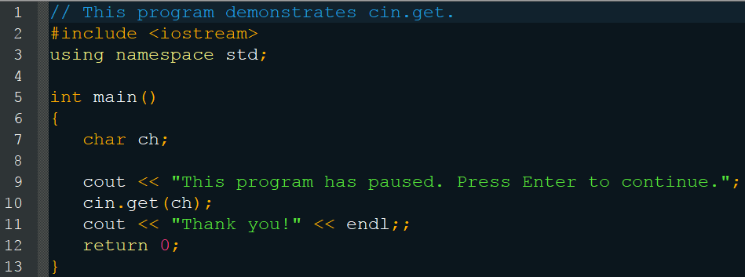
Reading a Character
This program has paused. Press Enter to continue. [Enter] Thank you!

Slide 59
Mixing cin >> and cin.get()
Be very careful, an unsuspected issue can arise if you are careless
char ch; int number; cout << “Enter a number: “; cin >> number; cout << “Enter a character: “; cin.get(ch); cout << “Thank You!”;
Enter a number: 100[Enter] Thank You!
1 | 0 | 0 | [Enter]

Slide 60
Mixing cin >> and cin.get()
Use a member function to prevent this
cin.ignore();
char ch; int number; cout << “Enter a number: “; cin >> number; cin.ignore(); cout << “Enter a character: “; cin.get(ch); cout << “Thank You!”;
Enter a number: 100[Enter] Enter a character: A[Enter] Thank You!
1 | 0 | 0 | [Enter] | A | [Enter]

Slide 61
cin.ignore()
Skips characters in the keyboard buffer
cin.ignore();
cin.ignore(number);
Skips “number” characters
cin.ignore(number, character);
Skips “number” characters or until the “character” is encountered
cin.ignore(20, ‘\n’);
1 | 0 | [Enter] | A | B

Slide 62
Object-Oriented Programing
cin is an object
Objects have their own functions called with the dot (.) operator (member functions)
cin.getline()
cin.get()
cin.ignore()
Member functions allow you to manipulate the data in the object
The combining of data and functionality within an object is called encapsulation

Slide 63
File Input and Output
If you want the program to remember or save information, you’ll need to use files
Always three steps
Open the file If it does not exist, it will be created
Read / Write data from / to the file
Close the file This will cause any changes to be saved

Slide 64
File Input and Output
#include <fstream>
This gives access to three object types
ofstream – output files
ifstream – input files
fstream – files that do both, we won’t use this yet
Create a file object based on one of these types
ifstream inputFile;
Use the member function to open it
inputFile.open(“customer.dat”);

Slide 65
Opening a File
File location
You can specify a file’s location manually when you open it
inputFile.open(“a:\\customer.dat”);
Note the two backslashes represent one, because of the escape characters
Alternatively, you can open the file as on the previous page, as long as the file is stored within the project’s self-named folder (for visual studio)
VisualStudio\Projects\TestProj\TestProj\customer.dat
inputFile.open(“customer.dat”);

Slide 66
Opening a File
You can also allow the user to specify the filename as well
ifstream inputFile; char fileName[20]; cout << “Enter the name of the file: “; cin >> fileName; inputFile.open(fileName);
You can also combine the object creation and open member function into one statement
ifstream inputFile(“customer.dat”);

Slide 67
Closing a File
Changes are not saved until the file is closed
Operating systems limit the number of files that can be opened
The software can slow down if too many files are open as well
Simply use the member function to close it
outputFile.close();
No more data can be writen to outputFile until it is reopened

Slide 68
Writing Data to a File
As simple as using cout, but you use the output file object’s name instead
outputFile << “Some text”;
outputFile << “Price: “ << price;
outputFile << “Line 1” << endl; outputFile << “Line 2\n”; outputFile << “Line 3”;
outputFile << 25; outputFile << 26 << 27 << 28;

Slide 69
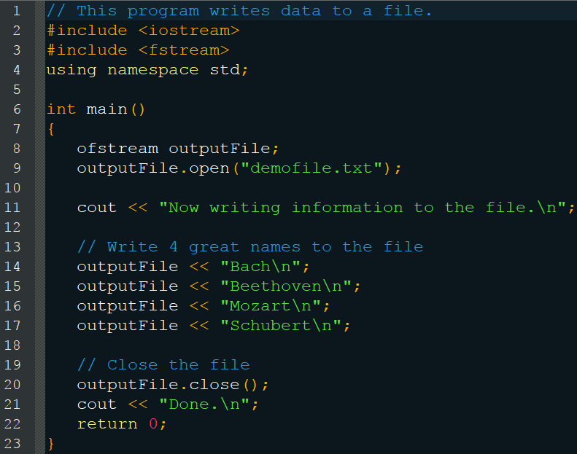
Writing Data to a File

Slide 70
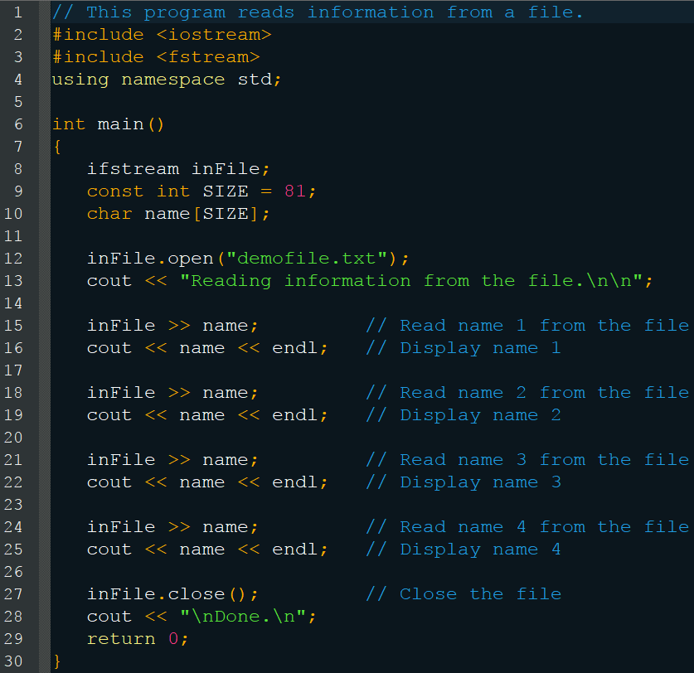
Reading Data from a File
As before, it is like using cin but with the file object’s name

Slide 71
Reading Data from a File

Slide 72
Reading and Writing Notes
By default, data is read from an input file sequentially beginning at the top
If the file does not exist, an error is thrown
By default, when you open a output file for writing, its previous data is erased
If the file does not exist, it will be created
In later chapters you will learn how to override these default behaviors

Slide 73
Reading and Writing Notes
Be careful when reading or writing data
The default behaviors of the cin and cout objects apply, specifically whitespace
istream inputFile(“numbers.txt”); int num1, num2, num3; cout << num1 << endl; cout << num2 << endl; cout << num3 << endl;
123 blank blank
numbers.txt
123
numbers.txt
1 2 3

